Slide 1
Dossier of Evidence Why is it necessary to scale up HIV testing in Europe?

Slide 2
Content
Know Your HIV epidemic: the Situation of HIV in Europe
Late Diagnosis of HIV Infection
Characteristics of Persons with Late Diagnosis
Consequences of Late Diagnosis
Barriers to HIV Testing
Overcoming Barriers to Testing
Monitoring and Evaluation
Conclusions

Slide 3
Know your HIV epidemic: the situation of HIV in Europe

Slide 4
Situation of HIV in Europe People Living with HIV
In the WHO European region, it is estimated that around 2.3 million people are living with HIV
In 2017, nearly 160 000 people were newly diagnosed with HIV in the region
An estimated 1 in 5 people are unaware of their infection
Key populations at higher risk of HIV in Europe are:
Men who have sex with men
People who inject drugs
Sex workers
Migrants
Prisoners
ECDC 2018 HIV/AIDS Surveillance in Europe 2018-2017 data

Slide 5
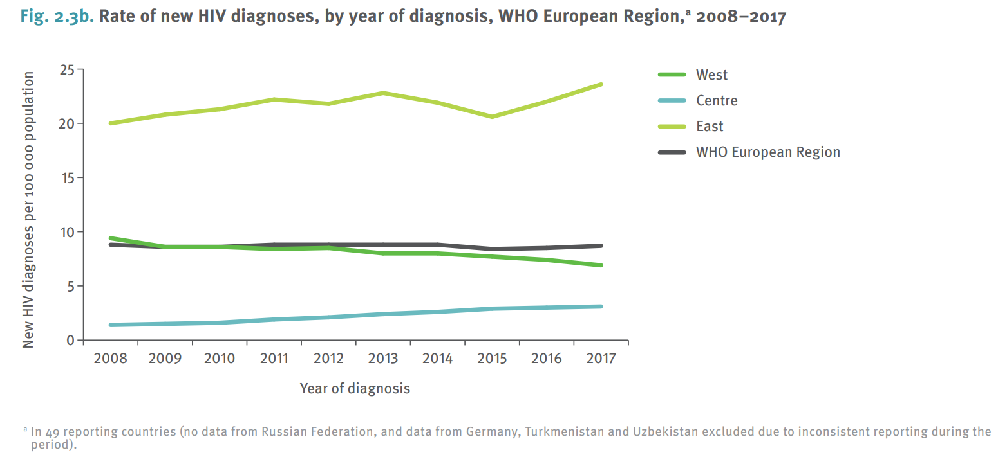
Situation of HIV in Europe Rate of newly reported HIV diagnoses, 2008-2017
Stagnated HIV epidemic in the West/Centre, escalating HIV epidemic in the Eastern region
ECDC 2018 HIV/AIDS Surveillance in Europe 2018-2017 data

Slide 6
Situation of HIV in Europe HIV Infections Diagnosed in 2017 WHO European Region
Characteristics of cases | WHO European Region* | West* | Centre* | East
Number of HIV cases | 159 420 | 22 354 | 6 205 | 130 861
Rate per 100 000 population | 20.0 | 6.9 | 3.2 | 51.1
Percentage of cases
Age 15-24 years** | 9.3% | 11.0% | 13.7% | 6.9%
Male-to-female ratio | 2.2 | 2.9 | 5.8 | 1.6
Transmission mode**
Heterosexual (men) | 25.3% | 16.7% | 19.4% | 33.9%
Heterosexual (women) | 24.1% | 17.5% | 7.3% | 33.7%
Sex between men | 21.2% | 39.7% | 28.4% | 3.9%
Injecting drug use | 13.0% | 2.7% | 2.7% | 24.1%
Mother-to-child transmission | 0.7% | 0.5% | 0.6% | 0.9%
Unknown | 15.4% | 22.5% | 41.2% | 3.4%
In Western Europe, the most common reported transmission mode for HIV is sex between men (MSM)
While in the Eastern region, the most commonly reported transmission modes are through heterosexual sex or injecting drug use.
www.testingweek.eu
www.hiveurope.eu
ECDC 2018 HIV/AIDS Surveillance in Europe 2018-2017 data

Slide 7
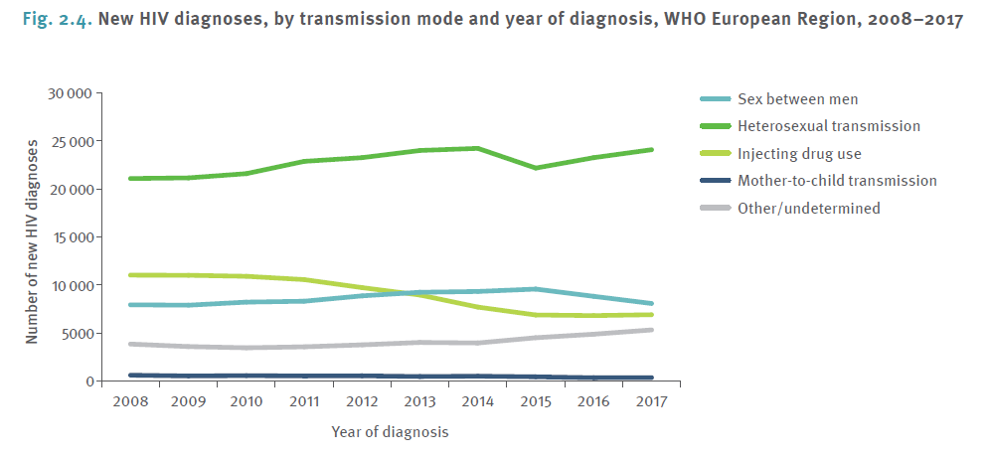
HIV infections diagnosed in the WHO European Region from 2008-2017 by transmission mode
ECDC 2018 HIV/AIDS Surveillance in Europe 2018-2017 data
ECDC/WHO. HIV/AIDS surveillance in Europe. 2015. Surveillance Report 2016

Slide 8
The HIV treatment continuum
Example from Belgium, showing ART uptake, retention in care and treatment success
Van Beckhoven D et al. Factors associated with the
continuum of care of HIV-infected patients in Belgium. J Int AIDS Soc. 2014

Slide 9
Know your HIV epidemic Template slide for national data
Populate this slide with the below:
Number of new diagnoses per year
Total number of people living with HIV (PLHIV)
PLHIV in need of treatment on ART
Key populations at higher risk of HIV
Geographical spread
Time trends
National HIV testing guidelines
Useful resources:
ECDC/WHO: HIV/AIDS surveillance in Europe. 2017 data. Surveillance Report (2018)
ECDC: Public health guidance on HIV, hepatitis B and C testing in the EU/EEA (2018)
WHO: Consolidated Guidelines on HIV Testing Services (2015)
www.testingweek.eu
www.hiveurope.eu
Notes:
These data are important to track to follow the trend(s) in the national epidemic – to know who, where and when to test.

Slide 10
Late Diagnosis of HIV Infection

Slide 11
What does late diagnosis/ presentation for HIV care mean?
The expression late presentation is used when people are unaware of their HIV infection and not diagnosed until their CD4 count is below 350 cells/mL or have an AIDS-defining event, regardless of the CD4 cell count
The expression presentation with advanced HIV disease is used when people are diagnosed with a CD4 count below 200 cells/mL or an AIDS-defining event, regardless of the CD4 cell count
European late presenter working group: Late presentation of HIV infection: A consensus definition, HIV Medicine 2010

Slide 12
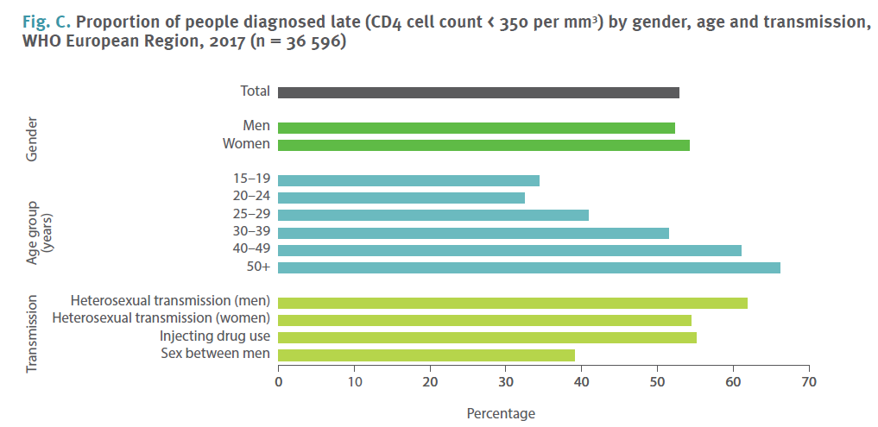
Late Diagnosis in Europe
Across the WHO European Region with available data in 2017:
53% of all HIV cases were diagnosed late
Including 32% with advanced HIV disease
ECDC 2018 HIV/AIDS Surveillance in Europe 2018-2017 data
Notes:
Not all countries have data on late diagnosed HIV infections.

Slide 13
Late Diagnosis in Europe
The COHERE study examined risk factors and outcomes for late presentation in Europe. Results from the study found that:
Late presenters decreased over time in both Central and Northern Europe among homosexual men, and male and female heterosexuals, but increased over time for female heterosexuals and male intravenous drug users (IDUs) from Southern Europe and in male and female IDUs from Eastern Europe.
Late presenters had 6-13 fold excess risk of contracting AIDS or die within first year after diagnosis
Earlier and more widespread testing, timely referrals after testing positive, and improved retention in care strategies are required to further reduce the incidence of late diagnosis across Europe (and elsewhere)
Mocroft A et al. Risk Factors and Outcomes for Late Presentation for HIV-Positive Persons in Europe: Results from the Collaboration of Observational HIV Epidemiological Research Europe Study (COHERE). PLoS Med, 2013

Slide 14
Late diagnosis of HIV infection Template slide for national data
Populate this slide with the below:
Percentages of new HIV cases who present with late diagnosis
Percentages of new HIV cases who present with advanced HIV infection
Useful resources:
ECDC/WHO: HIV/AIDS surveillance in Europe. 2017 Surveillance Report (2018)
Notes:
Available data on late diagnosed HIV infections and people diagnosed with advanced HIV disease can be found on the link on the slide.

Slide 15
Characteristics of Persons with Late HIV Diagnosis
www.testingweek.eu
www.hiveurope.eu

Slide 16
Characteristics of Persons with Late Diagnosis
Across Europe the most common characteristics of persons with late diagnosis include:
Migrant status
Being older
Being heterosexual
Living in low HIV prevalence areas
Being male
Having children
...but...
Adler A, Mounier-Jack S & Coker J
Late diagnosis of HIV in Europe: definitional and public health challenges AIDS Care 21, 03 (2009) 284-293.
www.testingweek.eu
www.hiveurope.eu
Notes:
Showing the most common characteristics across Europe of persons with late diagnosis of HIV.

Slide 17
Characteristics of Persons with Late Diagnosis
Characteristics vary from country to country
The prevalence of late diagnosis in any given risk group will depend on a number of factors and vary between countries. These factors include the following…
Local trends in the incidence of infection
The perception of risk by individuals
The availability of testing programmes and access to these
Awareness in healthcare settings of HIV and the willingness to carry out an HIV test
Laws discriminating PLHIV and high-risk groups
Notes:
... but characteristics vary from country to country and depend on of a number of factors. It is important, on a national basis, to identify factors that may led to late diagnoses of HIV infection and characteristics of persons with late diagnosis of HIV.

Slide 18
Consequences of Late Diagnosis

Slide 19
Consequences of Late Diagnosis
Increased mortality and morbidity
Increased transmission of HIV to uninfected people
Increased economic burden for healthcare systems
Notes:
There are 3 main consequences of late diagnosis; increased mortality and morbidity; increased transmission of HIV; and increased economic burden for health systems.

Slide 20
Consequences of Late Diagnosis Increased morbidity and mortality
Late diagnosis causes:
Increased risk of acquiring co-infections
Increased risk of treatment failure
A study in Spain found that compared to other HIV patients, the mortality risk of individuals with a late HIV diagnosis is 10-fold during the first year after diagnosis and two-fold between the first and fourth year post-diagnosis.
In their cohort, 71% of deaths of patients with late presentation and who died within one year of diagnosis were due to HIV/AIDS
Sobrino-Vegas P, Moreno S, Rubio R, Viciana P, Bernardino JI, Blanco JR et al. Impact of late presentation of HIV infection on short-, mid- and long-term mortality and causes of death in a multicenter national cohort: 2004–2013. Journal of Infection. 2016; 72(5): 587-596.

Slide 21
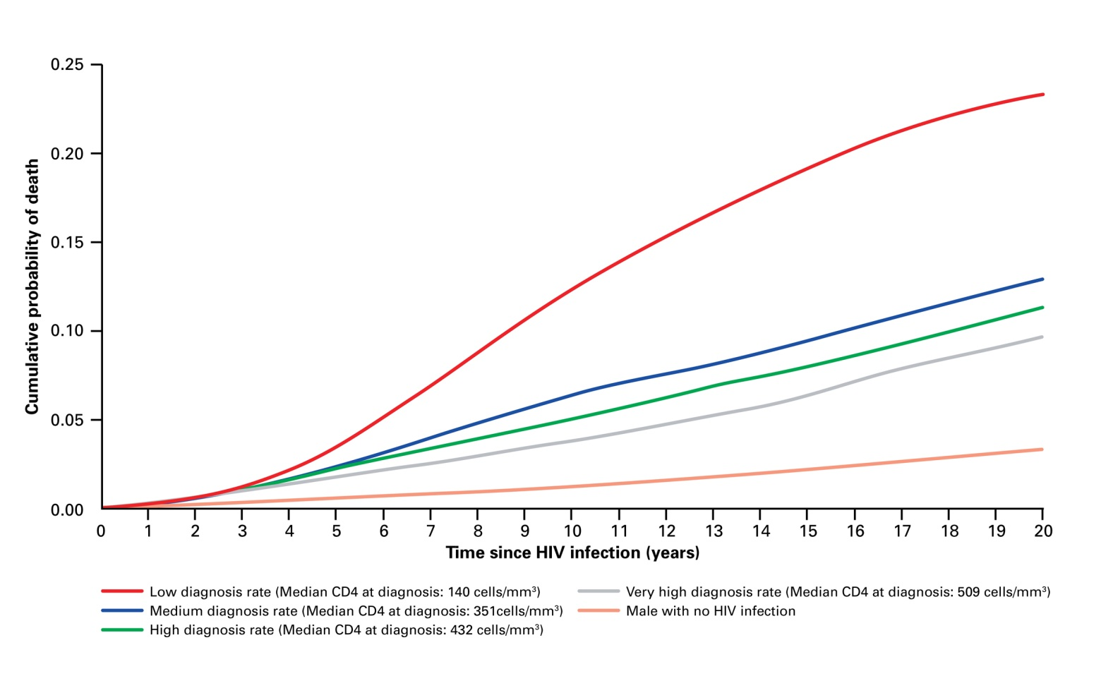
Consequences of Late Diagnosis Increased morbidity and mortality
Cumulative probability of death of people with HIV according to timing of diagnosis
www.testingweek.eu
www.hiveurope.eu
Nakawaga F et al. Projected life expectancy of people with HIV according to timing of diagnosis. AIDS 2011, 25.
Notes:
Showing the cumulative probability of death because of late diagnosis.
It is very clear that people diagnosed late have a much higher risk of HIV-related death (the red top line).

Slide 22
Benefits of Early Diagnosis
Earlier HIV diagnosis is one of the most important factors associated with better life expectancy
The benefits of early HIV testing on morbidity and mortality:
“With timely diagnosis, access to a variety of current drugs and good lifelong adherence, people with recently acquired infections can expect to have a life expectancy which is nearly the same as that of HIV negative individuals.”
Nakagawa F, May M, Phillips A. Life expectancy living with HIV: recent estimates and future implications. Curr Opin Infect Dis. 2013 Feb;26(1):17-25. doi: 10.1097/QCO.0b013e32835ba6b1.
Notes:
As also shown in the graph on the last slide, if diagnosed early and well treated, people can live with HIV almost as long as those who are HIV negative.

Slide 23
Consequences of Late Diagnosis Increased transmission of HIV
Late HIV diagnosis contributes to the spread of the HIV epidemic because:
People unaware of the HIV infection can lead to an increased risk of onward transmission
Recent results from the PARTNER study proves that HIV-positive people on effective ART with a supressed viral load do not transmit HIV onwards, supporting the message of the U=U (undetectable equals untransmittable) campaign, and the benefits of early testing and treatment for HIV
Additionally, evidence shows that people who know they are HIV positive decrease risk behaviour
Sobrino-Vegas P, Moreno S, Rubio R, Viciana P, Bernardino JI, Blanco JR et al. Impact of late presentation of HIV infection on short-, mid- and long-term mortality and causes of death in a multicenter national cohort: 2004–2013. Journal of Infection. 2016; 72(5): 587-596.
Rodger AJ, Cambiano V, Bruun T, Vernazza P, Collins S, Degen O et al. Risk of HIV transmission through condomless sex in serodifferent gay couples with the HIV-positive partner taking suppressive antiretroviral therapy (PARTNER): final results of a multicentre, prospective, observational study. Lancet. 2019: ;393(10189):2428-2438.

Slide 24
Benefits of Early Diagnosis Cost-effectiveness of HIV testing
Medical expenses for late diagnosis are up to 3.7 times as high as expenses for timely diagnosis and treatment
Even after 7 to 8 years, late diagnosis is still associated with higher cumulative expenses
HIV testing remains cost-effective as long as the undiagnosed HIV prevalence is above 0.1%
A 2017 study in Italy supports previously reported data that late presentation is associated with higher prevalence of non-infectious comorbidities and multimorbidity which contributes to higher total care costs
Krentz, HB & Gill MJ. Cost of medical care for HIV-infected patients within a regional population from 1997 to 2006. HIV Medicine (2008), 9, 721–730.
Fleishman JA, Yehia BR, Moore RD, Gebo KA& HIV Research Network . The Economic Burden of Late Entry Into Medical Care for Patients With HIV Infection. Med Care. 2010 December ; 48(12): 1071–1079.
Guaraldi G, Zona S, Menozzi M, Brothers TD, Carli F, Stentarelli C et al. Late presentation increases risk and costs of non-infectious comorbidities in people with HIV: an Italian cost impact study. AIDS Research and Therapy. 2017; 14(8).
Notes:
Late diagnosis of HIV is more expensive for health systems than early HIV diagnosis. The degree to which HIV screening is cost effective can vary with type, frequency and context; improving with increased undiagnosed HIV prevalence in the population being screened. Studies from the US and France suggest that HIV testing remains cost-effective as long as the undiagnosed HIV prevalence is above 0.1%. Below this threshold, consideration should be given to testing only in circumstances where the added cost of performing a test can be justified. Justifications include potentially adverse consequences if the HIV infection is not identified. Cost-effectiveness analyses assume that individuals diagnosed with HIV enter care and have access to antiretroviral therapy, and hence will benefit from treatment.

Slide 25
Benefits of Early Diagnosis Cost-effectiveness of HIV testing
Data from France showing HIV testing to be cost-effective when undiagnosed HIV prevalence is above 0.1%
//
0% 1% 5%
Undiagnosed HIV prevalence
Yazdanpanah Y et al. (2010) Routine HIV Screening in France: Clinical Impact and Cost-Effectiveness. PLoS ONE 5(10): e13132. doi:10.1371/journal.pone.0013132
http://www.plosone.org/article/info:doi/10.1371/journal.pone.0013132
www.testingweek.eu
www.hiveurope.eu
Notes:
Late diagnosis of HIV is more expensive for health systems than early HIV diagnosis. The degree to which HIV screening is cost effective can vary with type, frequency and context; improving with increased undiagnosed HIV prevalence in the population being screened. Studies from the US and France suggest that HIV testing remains cost-effective as long as the undiagnosed HIV prevalence is above 0.1%. Below this threshold, consideration should be given to testing only in circumstances where the added cost of performing a test can be justified. Justifications include potentially adverse consequences if the HIV infection is not identified. Cost-effectiveness analyses assume that individuals diagnosed with HIV enter care and have access to antiretroviral therapy, and hence will benefit from treatment.

Slide 26
Benefits of Early Diagnosis Cost-effectiveness of HIV testing
A UK modelling study which estimated cost-effectiveness of HIV testing in a primary care centre in a high HIV prevalence area found:
The cost-effectiveness ratios were £22,201 per quality-adjusted life-year (QALY) gained, £372,207 per death averted and £628,874 per HIV transmission averted (over a 40 year time period)
Factoring in higher costs for those diagnosed late, the study predicted that their trial would be cost-effective within 13 years
A modelling study in the Netherlands found:
A small increase in testing coverage targeted towards high-risk MSM resulted in 99 QALYs gained, and €0.9 million in savings.
Baggaley RF, Irvine MA, Leber W, Cambiano V, Figueroa J, McMullen H et al. Cost-effectiveness of screening for HIV in primary care: a health economics modelling analysis. Lancet HIV. 2017 Oct;4(10):e465-e474.
Reitsema M, Steffers L, Visser M, Heijne J, van Hoek AJ, Schim van der Loeff M, van Sighem A et al. Cost-effectiveness of increased HIV testing among MSM in The Netherlands. AIDS. 2019 Oct 1;33(12):1807-1817.

Slide 27
Benefits of Early Diagnosis Summary
Late presentation delays access to ART, adversely impacting the health of the individual while also allowing inadvertent onward transmission
The solution is, more effective strategies to
Test more effectively
Ensure better access to care for those diagnosed

Slide 28
Barriers to HIV Testing
www.testingweek.eu
www.hiveurope.eu

Slide 29
Barriers to HIV Testing
Barriers to HIV testing exist on three levels
Patient level
Healthcare provider level
Institutional/policy level
www.testingweek.eu
www.hiveurope.eu
Notes:
Barriers to HIV testing have to be confronted at different levels.

Slide 30
Barriers to ask for HIV Testing Patient Level
Patient level barriers vary from country to country – but cross-cultural barriers include:
Low-risk perception
Fear of HIV infection and its health consequences
Fear of disclosure (worries about stigma, discrimination and rejection by significant others)
Denial
Difficulty accessing service, especially migrant populations
Deblonde J et al. Barriers to HIV testing in Europe: a systematic review. European Journal of Public Health, 2010, Vol. 20, No. 4, 422–432.
Notes:
Barriers to HIV testing have to be confronted at different levels.

Slide 31
Barriers to offer HIV Testing Healthcare Provider Level
Healthcare provider level barriers to HIV testing:
Insufficient time
Burdensome consent process
Lack of knowledge/training
Pretest counselling requirements
Competing priorities
Inadequate reimbursement
Patient not perceived to be at risk
These barriers lead to many missed opportunities for HIV testing within healthcare setting encounters
Mounier-Jack S et al. HIV testing strategies across European countries. HIV Medicine (2008), 9 (Suppl. 2), 13–19.
Sullivan AK, Raben D, Reekie J, Rayment M, Mocroft A, et al. (2013) Feasibility and effectiveness of indicator condition-guided testing for HIV: results from HIDES I (HIV Indicator Diseases across Europe Study). PLoS One 8: e52845. doi:10.1371/journal.pone.0052845.
Partridge DG et al. HIV testing: the boundaries. A survey of HIV testing practices and barriers to more widespread testing in a British teaching hospital International Journal of STD & AIDS 2009; 20: 427-428.
Notes:
Barriers to HIV testing at healthcare provider level

Slide 32
Barriers to HIV Testing Institutional/Policy Level
Barriers at institutional/policy level:
Lack of national policy/guidelines for HIV testing
Laws and justice systems that jeopardise HIV prevention efforts
Laws that criminalise PLHIV (for not disclosing, exposing and transmitting)
Laws that criminalise sex workers, injecting drug users and men having sex with men
Laws that do not protect PLHIV against discrimination
Regulatory barriers which can be restrictive on
Who can test
Where tests can be taken
Disposal of testing materials
Types of tests allowed in a country
Global Commission on HIV and the Law. HIV and the Law: Risks, Rights & Health. UNDP, HIV/AIDS Group, 2012.
Notes:
Barriers to HIV testing at institutional/policy level.

Slide 33
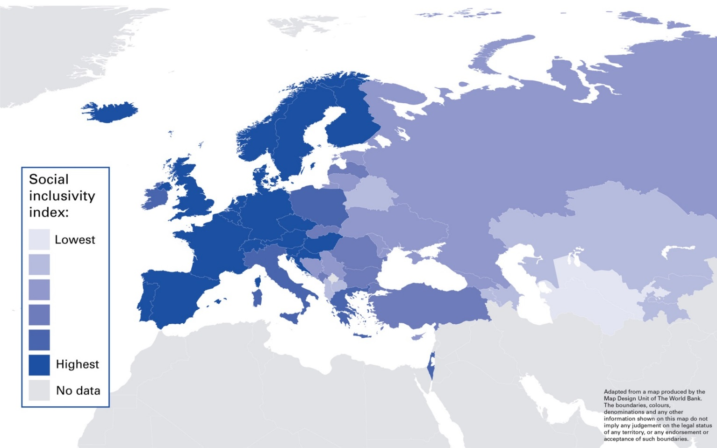
Barriers to HIV testing Laws and policy system/enabling legal and social environments for MSM (men who have sex with men)
Global Commission on HIV and the Law. HIV and the Law: Risks, Rights & Health. UNDP, HIV/AIDS Group, 2012
Notes:
The legal and social environments for MSM vary from country to country and influence barriers to HIV testing.

Slide 34
Barriers to HIV testing Template slide on country data
Populate this slide with the below:
What are the barriers to asking for an HIV test (patient level)?
What are the barriers to offering an HIV test (healthcare provider level)?
What are the barriers at an institutional/policy level?
Are policy/guidelines for HIV testing implemented?
Are laws and justice system jeopardising HIV prevention efforts?

Slide 35
Overcoming Barriers to HIV testing

Slide 36
Overcoming Barriers Implementation of national HIV testing guidelines
WHO published consolidated guidelines on HIV testing services in July 2015. These guidelines provide new recommendations for HIV testing.
These recommendations aim to scale up and improve HIV testing
In 2018, ECDC published their Public health guidance on HIV, hepatitis B and C testing in the EU/EEA – An integrated approach
This guidance acts as an update to their 2010 HIV testing guidance containing the latest evidence and also integrating testing for hepatitis B and C.
Some of the new recommendations are as follows…
Notes:
National guidelines on HIV testing should be implemented and in accordance with European guidelines from WHO or ECDC.

Slide 37
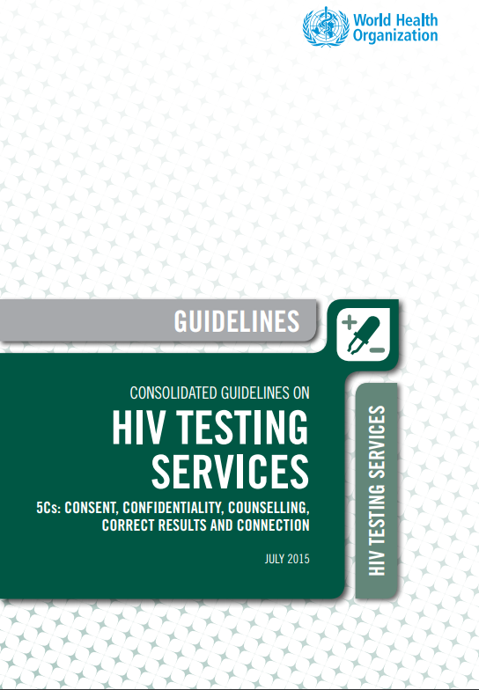
Overcoming Barriers Implementation of National HIV Testing Guidelines
The guidelines from WHO (2015) recommend:
Lay providers who are trained and supervised can independently conduct safe and effective HIV testing using RDTs to support task sharing in the health sector.
Further, to close these various gaps in coverage and quality, more proactive, rights-based HIV testing approaches are needed.
It is recommended to offer retesting at least annually to people from key populations and to HIV-negative partners in serodiscordant couples. Depending on client risk behaviours, more frequent voluntary retesting should be offered and available.
World Health Organization. Consolidated Guidelines on HIV Testing Services. 2015

Slide 38
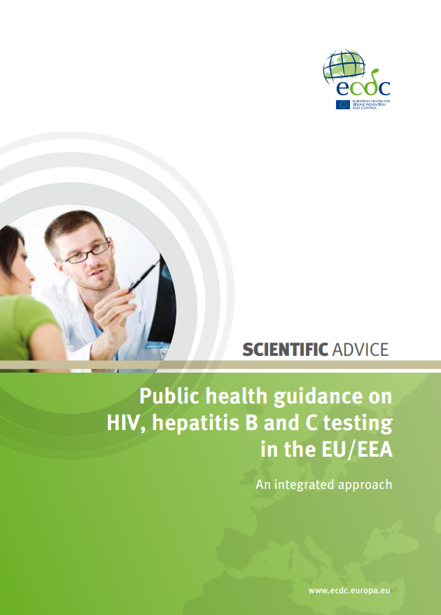
Overcoming Barriers Implementation of National HIV Testing Guidelines
ECDC Public health guidance on HIV, hepatitis B and C testing in the EU/EEA – An integrated approach (2018) recommends developing testing programmes/policy based in below six principles:
An effective national testing strategy, including a monitoring and evaluation framework, is critical in responding to HIV, HBV and HCV infection.
Testing should be accessible, voluntary, confidential and contingent on informed consent.
Appropriate information should be available before and after testing.
Linkage to care is a critical part of an effective testing programme.
Normalising HIV, HBV and HCV testing in all healthcare settings; and
Those carrying out HIV, HBV and/or HCV testing should receive appropriate training and education.
.ECDC Public health guidance on HIV, hepatitis B and C testing in the EU/EEA – An integrated approach (2018)

Slide 39
Overcoming Barriers Outreach to populations at higher risk of HIV
Many people belonging to populations at higher risk of HIV are in limited contact with the healthcare system.
WHO recommends that:
‘HIV testing services should be routinely offered to all key populations in the community, closed settings such as prisons, and clinical settings.’
‘Community-based HIV testing services for key populations, with linkage to prevention, treatment and care services, is recommended in addition to provider initiated testing and counselling’ Offer tests at needle and syringes programmes’
‘Couples and partners should be offered HIV testing services with support for mutual disclosure. This applies also to couples and partners from key populations’
WHO/Europe. Scaling up HIV testing and counselling in the WHO European Region, 2010.
Notes:
Populations at higher risk must be targeted with special interventions.

Slide 40
Overcoming Barriers Outreach to populations at higher risk
The ECDC guidance identifies the following population groups suitable for targeted HIV, HBV and HCV testing due to higher risk of infection and suggest to offer tests to:
men who have sex with men (MSM)
trans* people
people who inject drugs (PWID)
migrants
household contacts of people diagnosed with HBV
homeless people
sex workers
people in prison
pregnant women
haemodialysis patients
people who have received blood products, organs or surgical interventions before adequate safety and quality regulations were enforced; and
sexual or injecting partners of people diagnosed with HIV, HBV and HCV.
.ECDC Public health guidance on HIV, hepatitis B and C testing in the EU/EEA – An integrated approach (2018)

Slide 41
Overcoming Barriers Normalisation of HIV testing
More offers for HIV tests to increase acceptability to patients. In many settings, patients were more likely to accept an HIV test when offered. Studies have shown that when an HIV test was offered, 83% of acute medical care patients and 96% of patients across an Emergency Department, Acute Care Unit, Dermatology Outpatients and Primary Care facility accepted testing
But tests are often not offered, e.g. only 43% cases of tuberculosis were also tested for HIV
High variability between clinicians in offering HIV tests e.g. 45-88% among doctors
Thus, missed opportunities for HIV testing
However, opt-out (automatic) testing leads to increased testing rates, e.g. 96% for antenatal screening in UK in 2010
Ellis S et al. Clinical Medicine 2011; 11: 541-3.
Thomas William S et al. Int J STD & AIDS 2011; 22: 748-50.
Petlo T et al. Int J STD & AIDS 2011; 22: 727-9.
National Antenatal Infections Screening Monitoring. HPA.
Rayment M et al. HIV Testing in Non-Traditional Settings – The HINTS Study: A Multi-Centre Observational Study of Feasibility and Acceptability. PLOS One, 2012
Notes:
Most people accept an offer of an HIV-test.

Slide 42
Approaches to Testing Complimentary Testing is Effective
Self Referral
Healthcare facilities
Community based testing (check points)
Home-sampling/home testing
Provider-Initiated
All (non-targeted)
Subgroup (targeted)
Ethnicity, country of origin, sexual preference, etc
Type of condition presenting

Slide 43
Overcoming Barriers Indicator Condition Guided HIV testing
An approach by which healthcare professionals can be encouraged to test more patients based on suspicion of HIV
In healthcare settings where HIV testing is not part of standard medical care, HIV testing should be offered routinely for certain clinical conditions
A number of diseases can indicate an undiagnosed HIV infection
It has been demonstrated that testing for these ‘indicator diseases’ will detect higher than average rates of HIV and is a cost-effective intervention
Useful resources:
EuroTEST (formerly HIV in Europe): HIV Indicator Conditions: Guidance for Implementing HIV Testing in Adults in Health Care Settings (2012)
HIV in Europe. HIV Indicator Conditions: Guidance for implementing HIV testing in adults in Health Care Settings 2012.
Notes:
People with specific diseases should be offered an HIV test in healthcare settings where HIV testing is not part of standard medical care.

Slide 44
Overcoming Barriers Indicator Condition Guided HIV testing
Feasibility and Effectiveness
Indicator condition guided testing is an effective method of targeting HIV testing
 | Individuals having HIV test (number) | HIV positive (number) | Prevalence (95% Cl)
Total | 3588 | 66 | 1.84 (1.42 – 2.34)
Indicator condition
Sexually transmitted infection (STI) | 764 | 31 | 4.06 (2.78 – 5.71)
Malignant lymphoma (LYM) | 344 | 1 | 0.26 (0.006 – 1.61)
Cervical or anal dysplasia or cancer (CAN) | 542 | 2 | 0.37 (0.04 – 1.32)
Herpes zoster (HZV) | 207 | 6 | 2.89 (1.07 – 6.21)
Hepatitis B or C (HEP) | 1099 | 4 | 0.36 (0.10 – 0.93)
Ongoing mononucleosis-like illness (MON) | 441 | 17 | 3.85 (2.26 – 6.10)
Unexplained leukocytopenia/thrombocytopenia (CYT) | 94 | 3 | 3.19 (0.66 – 9.04)
Seborrheic dermatitis/exanthema (SEB) | 97 | 2 | 2.06 (0.25 – 7.24)
 | North | West Central | East Central | South
Total number of tests (%) | 1288 (35.9) | 459 (12.8) | 1412 (39.4) | 429 (12.0)
Number tested HIV positive | 8 (0.6) | 17 (1.5) | 23 (1.6) | 28 (6.5)
Sullivan et al. Feasibility and Effectiveness of Indicator Condition-Guided Testing for HIV: Results from HIDES I (HIV Indicator Diseases across Europe Study). PLOS ONE 2013.
www.testingweek.eu
www.hiveurope.eu

Slide 45
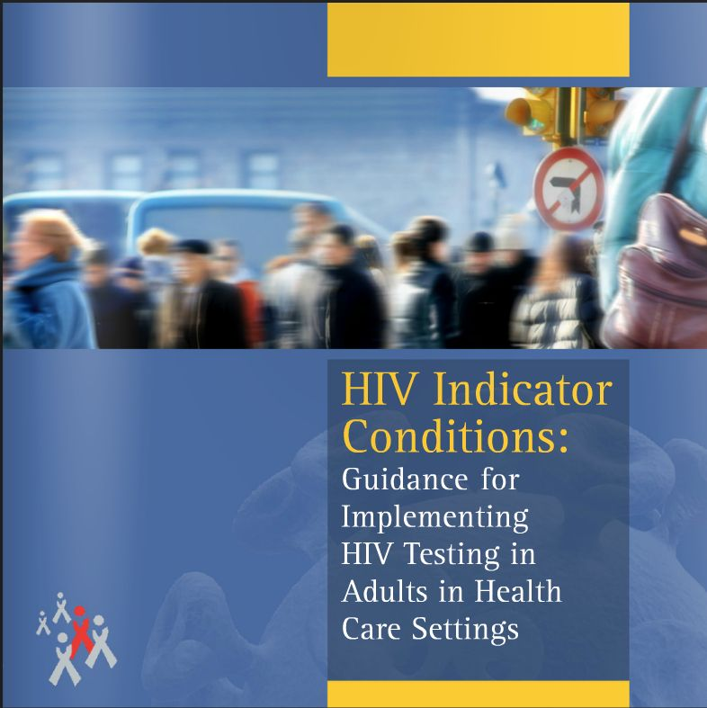

Slide 46
Monitoring and Evaluation

Slide 47
Monitoring and Evaluation
Monitoring and evaluation (M&E) is an essential component of an HIV testing programme and ensures that the programme provides high quality HIV testing
FACTS criteria can be used when designing M&E:
Feasibility
Acceptability
Effectiveness and Cost-effectiveness
Target populations are reached
Sustainability
ECDC, HIV testing: increasing uptake
and effectiveness in the European Union, 2010.
Notes:
Monitoring and evaluating HIV testing programmes are essential.

Slide 48
Monitoring and Evaluation Examples of indicators to assess local HIV testing initiatives using FACTS criteria
Criteria for project success | Examples of indicators
Feasibility | Number and % of persons offered HIV testing
 | % newly diagnosed individuals who are successfully transferred to care within three months
Acceptability | Number and % uptake of an HIV test (overall and among populations at higher risk)
 | % of patients agreeing that the offer of an HIV test in this setting is acceptable
 | % of patients willing to disclose risk behaviour
 | % of staff reporting barriers to offer an HIV test in this setting
 | % of staff reporting specific training needs
Effectiveness and Cost effectiveness | Positivity rate (overall and among populations at higher risk)
 | Staff costs associated with intervention
 | Resource costs associated with intervention
 | Outcome of cost-effectiveness model
Target populations reached | % of populations at higher risk who had an HIV test in the last 12 months and know their results
 | Positivity rate among populations at higher risk tested in the setting
Sustainability | Number and % uptake of an HIV test (overall and among populations at higher risk)
 | Staff costs associated with intervention
 | Resource costs associated with intervention
ECDC, HIV testing: increasing uptake and effectiveness in the European Union, 2010.
Notes:
Examples of indicators to assess HIV testing initiatives using FACTS criteria.

Slide 49
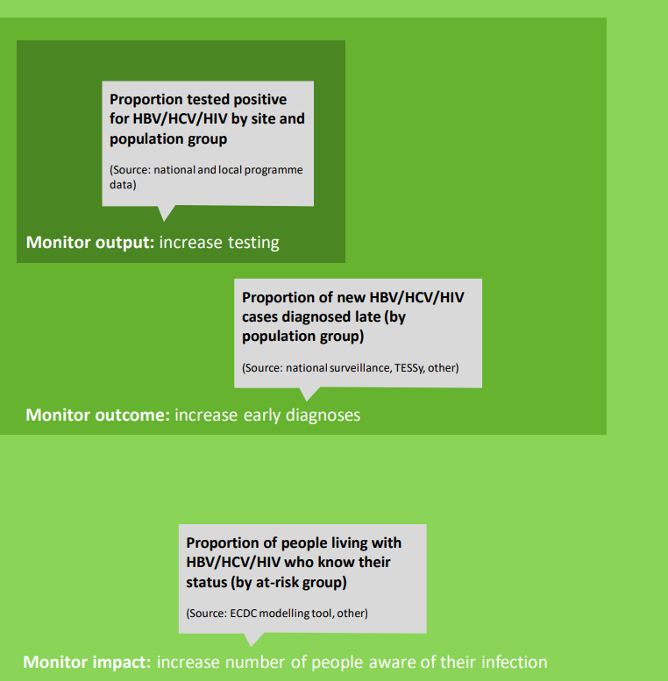
Monitoring and Evaluation Monitoring integrated national testing strategies or programmes for HBV, HCV and HIV
Main elements of a monitoring framework for viral hepatitis and HIV testing recommended by ECDC
.ECDC Public health guidance on HIV, hepatitis B and C testing in the EU/EEA – An integrated approach (2018)

Slide 50
Monitoring and Evaluation Examples of indicators for monitoring at national level
Examples of indicators
Process Indicators | Existence of national testing policies and guidelines that are consistent with international standards (WHO/UNAIDS)
 | % men and women who had an HIV test in the last 12 months and know the results
 | % of populations at higher risk (MSM, IDU, migrants) who had an HIV test in the last 12 months and know their results
 | % of pregnant women who have been tested for HIV in the last 12 months and know their results
 | % of TB patients who have been tested for HIV in the last 12 months and know their results
 | % of STI patients who have been tested for HIV in the last 12 months and know their results
 | Number and proportions of persons offered testing stratified by setting (particularly, anonymous testing sites and primary care sites)
Outcome indicators | Total number of new diagnoses stratified by populations at higher risk including unknowns
 | Number and % of new diagnoses which are diagnosed late with CD4 <200 (overall and by population at higher risk) Number and % of new diagnoses which are diagnosed late with CD4 <350 (overall and by population at higher risk) Number and % of new diagnoses which are diagnosed late with AIDS at presentation (overall and by overall and by population at higher risk)
 | % new diagnoses who are recently infected (RITA or other seroconversion algorithms)
 | % of newly diagnosed individuals who are successfully transferred to care within three months (overall and by population at higher risk)
 | Total number and proportion of undiagnosed infections
 | Number and proportion in populations at higher risk of undiagnosed infections
ECDC, HIV testing: increasing uptake and effectiveness in the European Union, 2010.
Notes:
Examples of indicators for monitoring at national level.

Slide 51
Monitoring and Evaluation Template slide on country data
Populate this slide with the below:
Has a robust monitoring and evaluation system been implemented?
What criteria has been used when deciding indicators?
Useful resources:
ECDC: Public health guidance on HIV, hepatitis B and C testing in the EU/EEA (2018)

Slide 52
Conclusions

Slide 53
Conclusions
Rationale for HIV testing (as well as, timely treatment and care):
Reduce mortality and morbidity
Reduce the onward transmission of HIV
Lessen the economic burden for health systems
Barriers to HIV testing may exist at three different levels:
Patient level
Healthcare provider level
Institutional/policy level
Notes:
The benefits of early HIV testing.

Slide 54
Conclusions
Populations at high risk should be targeted with focused interventions
National HIV testing guidelines should be implemented and should take an ethical approach based on human rights principles aligning with international recommendations
Training and awareness raising is crucial in order to normalise HIV testing in the healthcare system, e.g. by implementing indicator condition-guided HIV testing
Laws that jeopardise HIV prevention efforts should be abolished
Monitoring and evaluation systems should be implemented
Notes:
Barriers to HIV testing can be confronted at different levels.

Slide 55
Examples of Efforts to Scale Up HIV Testing
For examples of testing initiatives visit:
www.testingweek.eu

